Slide 1

Face Recognition M. Sriram - 21071A6636 B. Mokshagna-21071A6606 D. Aravind – 21071A6616 M. Likitha – 21071A6639 R. Yashwanth - 21071A6652

Slide 2
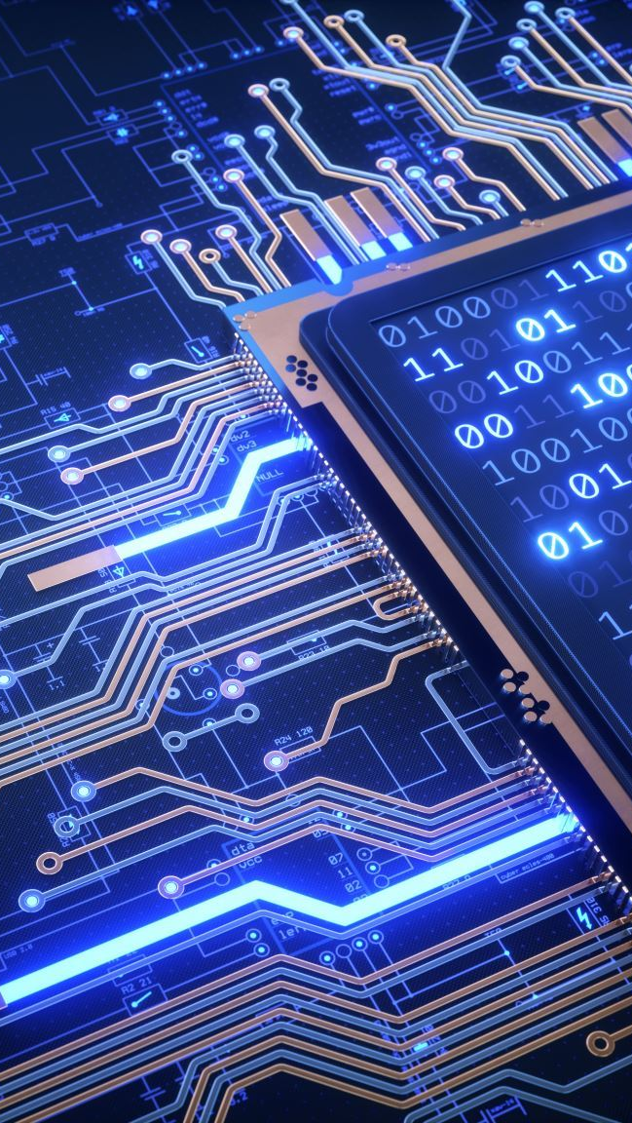
ABSTRACT
The Face Recognition Project explores advanced computer vision techniques to develop a robust and efficient system for recognizing and verifying individuals based on facial features
Leveraging deep learning algorithms, the project aims to enhance accuracy and speed in facial identification, ensuring seamless integration into security and authentication applications
The project emphasizes ethical considerations, addressing privacy concerns through careful implementation of data protection measures

Slide 3

INDEX
Introduction
Literature
Requirements
Implementation
Advantages
Conclusion
References

Slide 4

Introduction
The Face Recognition Project heralds a paradigm shift in biometric technology, aiming to redefine identity verification through the integration of cutting-edge facial recognition systems
The human face serves as a unique and natural identifier, making face recognition an intuitive and non-intrusive means of authentication
This introduction aims to provide an overview of the evolution of face recognition technology, starting from its early roots in computer vision to the current state-of-the-art deep learning approaches

Slide 5

Literature
The Literature Review serves as an exhaustive exploration of the dynamic and expansive field of facial recognition technology
Delving into seminal research papers, recent breakthroughs, and critical discussions surrounding various methodologies, this section offers a nuanced understanding of the current state of the art
This critical analysis informs the project's unique contribution and positions it within the broader academic and technological discourse

Slide 6

Requirements
The Requirements section provides a meticulous blueprint, defining the technical, functional, and ethical parameters crucial for the successful implementation of the Face Recognition Project
Ethical considerations are woven into the fabric of the project's foundation, with a thorough exploration of data collection protocols and privacy safeguards
This section acts as a compass for project stakeholders, guiding them through the intricacies of project setup and fostering a culture of responsible data handling in the development process

Slide 7
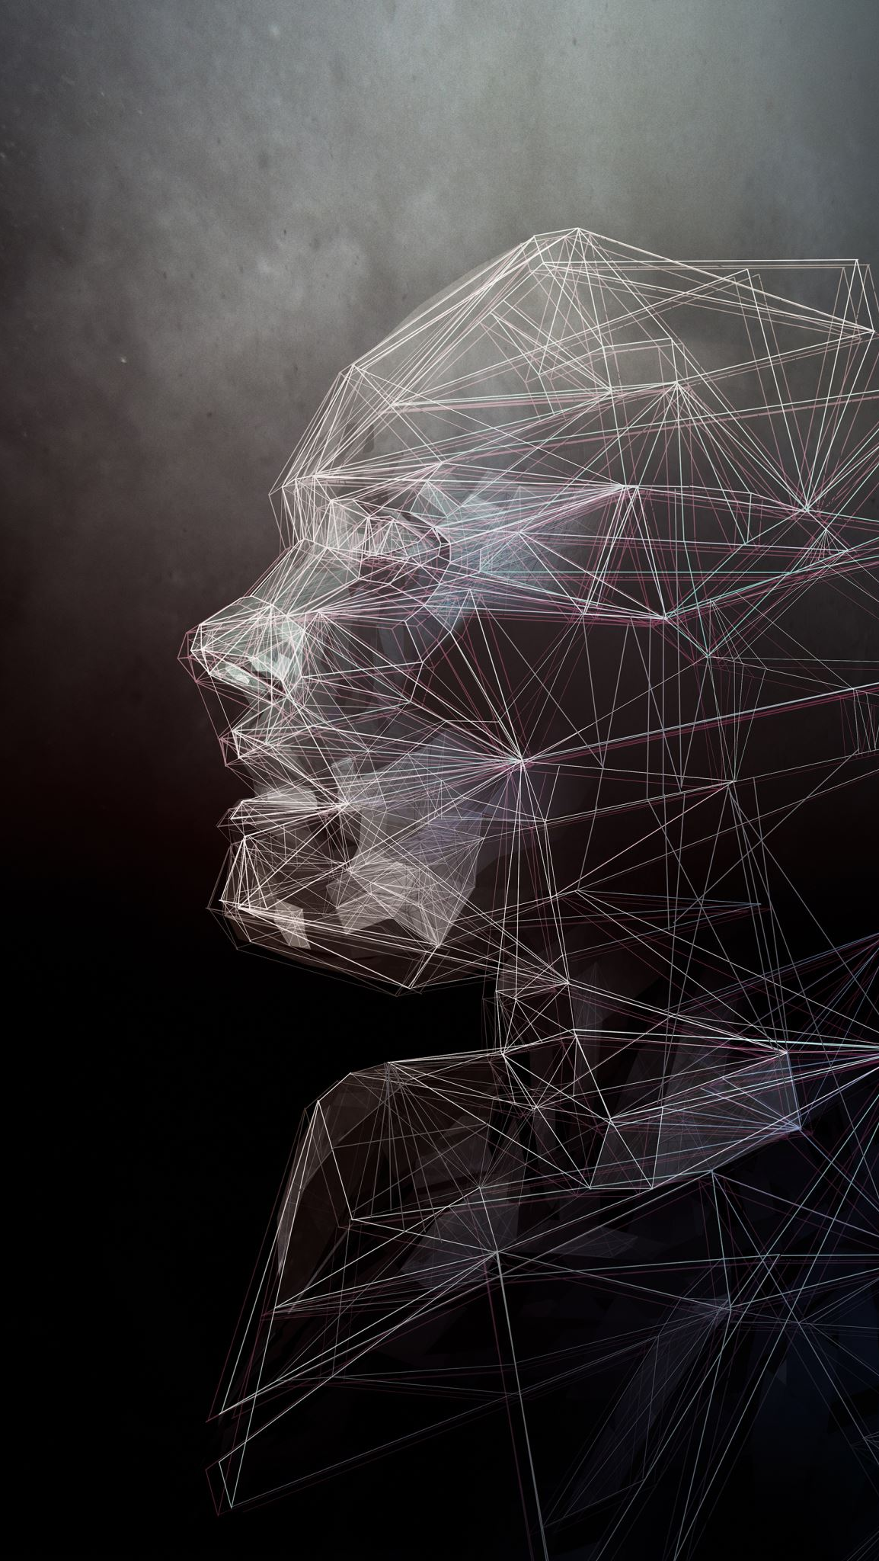
Implementation
import cv2
import numpy as np
from PIL import Image
import os
# Path for face image database
path = 'dataset'
recognizer = cv2.face.LBPHFaceRecognizer_create()
detector = cv2.CascadeClassifier("haarcascade_frontalface_default.xml");
# function to get the images and label data
def getImagesAndLabels(path):
imagePaths = [os.path.join(path,f) for f in os.listdir(path)]
faceSamples=[]
ids = []
for imagePath in imagePaths:
PIL_img = Image.open(imagePath).convert('L') # convert it to grayscale
img_numpy = np.array(PIL_img,'uint8')
id = int(os.path.split(imagePath)[-1].split(".")[1])

Slide 8
Implementation
faces = detector.detectMultiScale(img_numpy)
for (x,y,w,h) in faces:
faceSamples.append(img_numpy[y:y+h,x:x+w])
ids.append(id)
return faceSamples,ids
print ("\n [INFO] Training faces. It will take a few seconds. Wait ...")
faces,ids = getImagesAndLabels(path)
recognizer.train(faces, np.array(ids))
# Save the model into trainer/trainer.yml
recognizer.write('trainer/trainer.yml')
# Print the numer of faces trained and end program
print("\n [INFO] {0} faces trained.".format(len(np.unique(ids))))

Slide 9

Main
Import os
from tkinter import *
from tkinter import ttk
from PIL import Image, ImageTk
zrom tkinter import messagebox
import mysql.connector
import cv2
import numpy as np
class Train:
def __init__(self, root):
self.root = root
self.root.geometry('1530x790+0+0')
self.root.title('face recognition system')
title_lbl = Label(self.root, text="TRAIn DATA SET",
font=("times now roman", 35, "bolf"),
bg="white", fg="darkgreen")
title_lbl.place(x=0, y=0, width=1530, height=45)
img_top = Image.open(r"")

Slide 10
Main
img_top = img_top.resize((1530, 325), Image.ANTIALIAS)
self.photoimg_top = ImageTk.PhotoImage(img_top)
f_lbl = Label(self.root, image=self.photoimg_top)
f_lbl.place(x=0, y=55, width=1530, height=325)
# button
b1_1 = Button(self.root, text="TRAIN DATA", command=self.train_classifier(), cursor="hand")
b1_1.place(x=0, y=300, width=1530, height=60)
img_bottom = Image.open(r"")
img_bottom = img_bottom.resize((1530, 325), Image.ANTIALIAS)
self.photoimg_bottom = ImageTk.PhotoImage(img_bottom)
f_lbl = Label(self.root, image=self.photoimg_bottom)
f_lbl.place(x=0, y=440, width=1530, height=325)
def train_classifier(self):
data_dir = ("data")
path = [os.path.join(data_dir, file) for file in os.listdir(data_dir)]
faces = []

Slide 11
Main
ids = []
for image in path:
img = Image.open(image).convert('L') # Gray
imageNp = np.array(img, 'uint8')
id = int(os.path.split(image)[1].split('.'[1]))
faces.append(imageNp)
ids.append(id)
cv2.imshow("Training", imageNp)
cv2.waitKey(1) == 13
ids = np.array(ids)
# ---------- Train the classifier and sve ----
clf = cv2.LBPHFaceRecognizer_create()
clf.train(faces, ids)
clf.write("classifier.xml")
cv2.destroyAllWindows()
messagebox.showinfo("Result", "Training datasets completed!!")

Slide 12
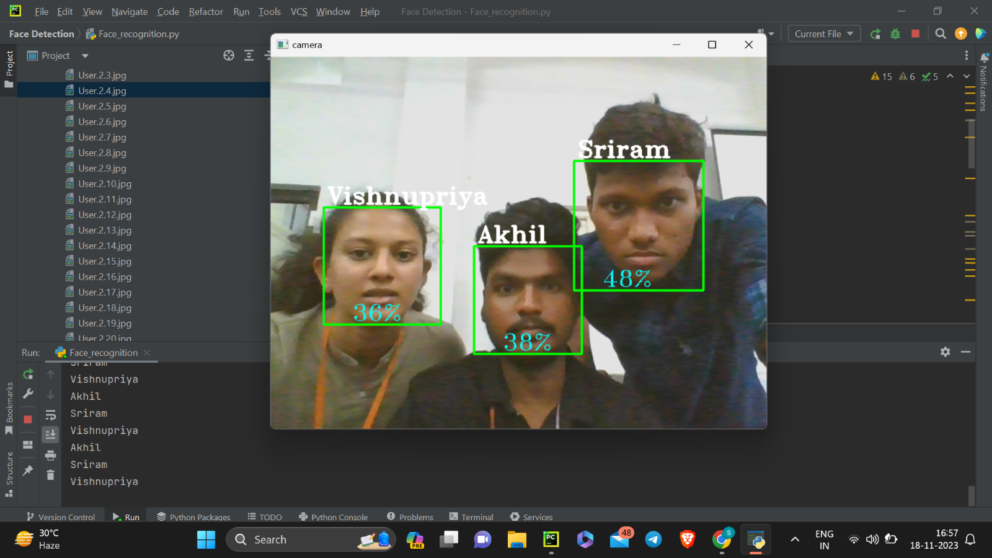
Sample Training Images

Slide 13
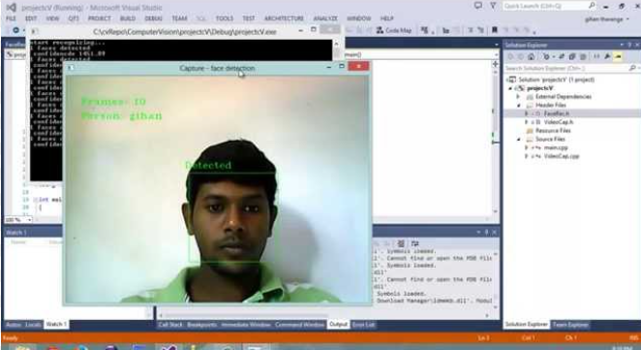
Sample Training Images

Slide 14

Advantages
Expanding on the practical implications, the Advantages section delves into the transformative potential of the Face Recognition Project across diverse sectors
It meticulously enumerates the benefits, such as heightened security measures, seamless user authentication, and improved operational efficiency
The section also examines the potential for societal impact, addressing concerns such as accessibility, bias, and the ethical implications of widespread facial recognition technology adoption

Slide 15

Conclusion
In conclusion, face recognition technology has witnessed remarkable advancements, transforming the landscape of biometrics, security, and human-computer interaction
The journey has been marked by breakthroughs in feature extraction, model architectures, and training methodologies, catapulting face recognition into widespread applications, including surveillance, access control, and personalized user experiences
The comprehensive review has highlighted persistent issues related to biases, privacy concerns, and ethical implications of widespread face recognition adoption

Slide 16

References
Face Detection and Recognition System for Enhancing Security Measures Using Artificial Intelligence System Muhammad Farhan Siddiqui, Waqas Ahmed Siddique, Mushtaq Ahmedh and Awais Khan Jumani
ARTIFICIAL INTELLIGENCE APPLICATIONS FOR FACE RECOGNITION IN RECRUITMENT PROCESS Nawaz, Nishad
Face Recognition and Identification using Deep Learning Approach
A Face Recognition System using PCA and AI Technique
Review on Facial-Recognition-Based Applications in Disease Diagnosis
Detection strategies for face recognition using learning and evolution Huang, Ren-Jay Jeffrey George Mason University ProQuest Dissertations Publishing
Facial Recognition using OpenCV
Deep face recognition using imperfect facial data

